Slide 1
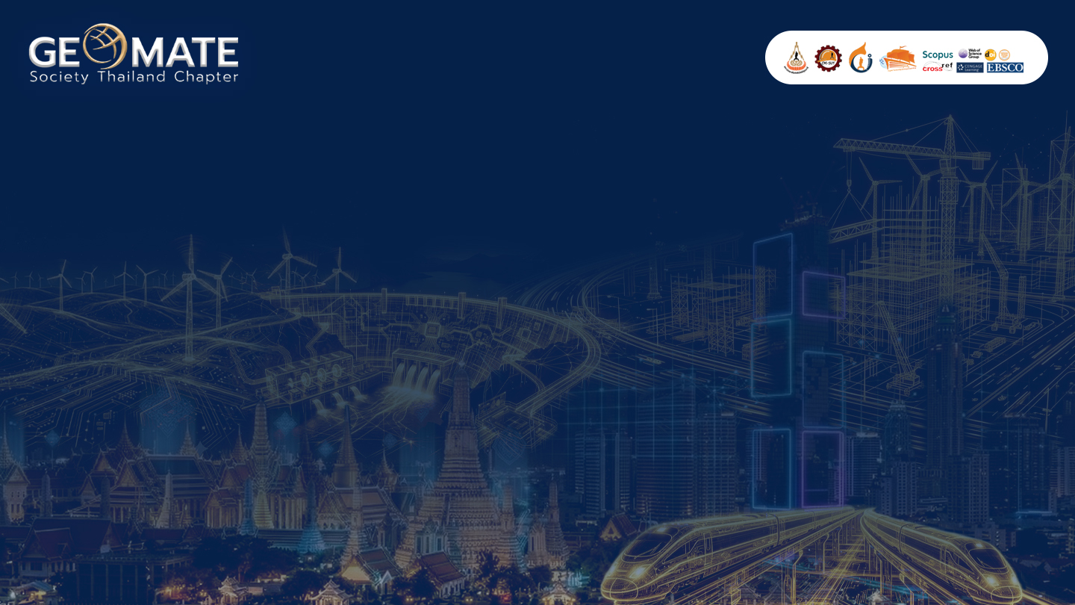
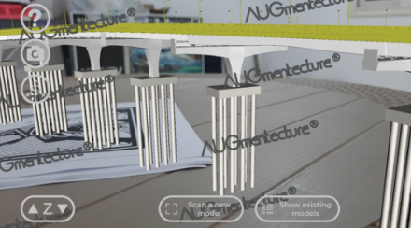
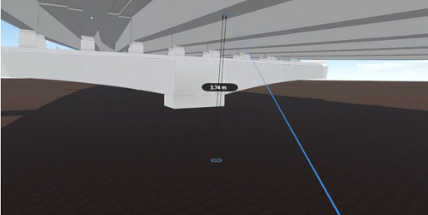
The 16th International Conference
GEOMATE 2026
INTEGRATING BUILDING INFORMATION MODELLING (BIM) AND EXTENDED REALITY (XR) IN THE TRANSPORTATION INFRASTRUCTURE INDUSTRY
Abstract
Case study
Although building information modelling (BIM) has been widely used in the build ing industry, its usage in infrastructure projects such as bridges has been very chal lenging. Extended Reality (XR) that simulates a construction project is still considered a new technology in the Architecture, Engineering, and Construction (AEC) industry. This paper investigates the viability of integrating both BIM and XR technologies into transportation infrastructure projects. A fully integrated workflow for introducing different XR, Augmented Reality (AR), and Virtual Reality (VR), and BIM technologies using different software for a case study of El-Merghani bridge, a reinforced concrete girder type bridge, was developed.
This section provides the detailed process and results of applying the developed BIM-to-XR workflow on El-Merghani bridge, starting from developing the geospatial context tilldocumentation, simulation, and visualization of the project.
Examining potential cost reduction resulting from the utilization of VR and AR technologies on typical bridges construction
Introduction
Building Information modelling (BIM) has become widely used in the AEC industry dueto its tremendous benefits in recent years. BIM is a process that integrates and visualizesdifferent project data and provides important diverse information on the implementedproject which assists project managers in making accurate project decisions (Wei et al.2021). BIM has the capacity to improve the management and implementation of largescale construction projects including extremely complicated bridge projects
The total cost of a construction project typically comprises direct cost, indirect cost,overhead, and markup. The markup part always includes a contingency sum to secureprobable risks to a project which usually forms an amount that cannot be underestimated. In this part, the current research aims
Methodology
This section presents a brief introduction for the proposed workflow to produce adetailed 4D BIM model and its visualization through different XR technologies (AR andVR). The proposed workflow is to integrate different software to accumulate their associated benefits to provide a comprehensive bridge model accounting for geometric roaddesign, topological data, structural details and the surroundings to visualize the aesthetics of the proposed bridge.
Results & Discussion
This section presents a brief introduction for the proposed workflow to produce adetailed 4D BIM model and its visualization through different XR technologies (AR andVR). The proposed workflow is to integrate different software to accumulate their associated benefits to provide a comprehensive bridge model accounting for geometric roaddesign, topological data, structural details and the surroundings to visualize the aesthetics of the proposed bridge.
Building Information modelling (BIM) has become widely used in the AEC industry dueto its tremendous benefits in recent years. BIM is a process that integrates and visualizesdifferent project data and provides important diverse information on the implementedproject which assists project managers in making accurate project decisions (Wei et al.2021). BIM has the capacity to improve the management and implementation of largescale construction projects including extremely complicated bridge projects
Building Information modelling (BIM) has become widely used in the AEC industry dueto its tremendous benefits in recent years. BIM is a process that integrates and visualizesdifferent project data and provides important diverse information on the implementedproject which assists project managers in making accurate project decisions (Wei et al.2021). BIM has the capacity to improve the management and implementation of largescale construction projects including extremely complicated bridge projects
Conclusion
This section presents a brief introduction for the proposed workflow to produce adetailed 4D BIM model and its visualization through different XR technologies (AR andVR). The proposed workflow is to integrate different software to accumulate their associated benefits to provide a comprehensive bridge model accounting for geometric roaddesign, topological data, structural details and the surroundings to visualize the aesthetics of the proposed bridge.
Eastin Grand Hotel Sathorn Bangkok, Thailand 17th - 19th November 2026
Eastin Grand Hotel Sathorn Bangkok, Thailand 17th - 19th November 2026

Slide 2
The 16th International Conference
GEOMATE 2026
INTEGRATING BUILDING INFORMATION MODELLING (BIM) AND EXTENDED REALITY (XR) IN THE TRANSPORTATION INFRASTRUCTURE INDUSTRY
Eastin Grand Hotel Sathorn Bangkok, Thailand 17th - 19th November 2026
Eastin Grand Hotel Sathorn Bangkok, Thailand 17th - 19th November 2026

